Slide 1
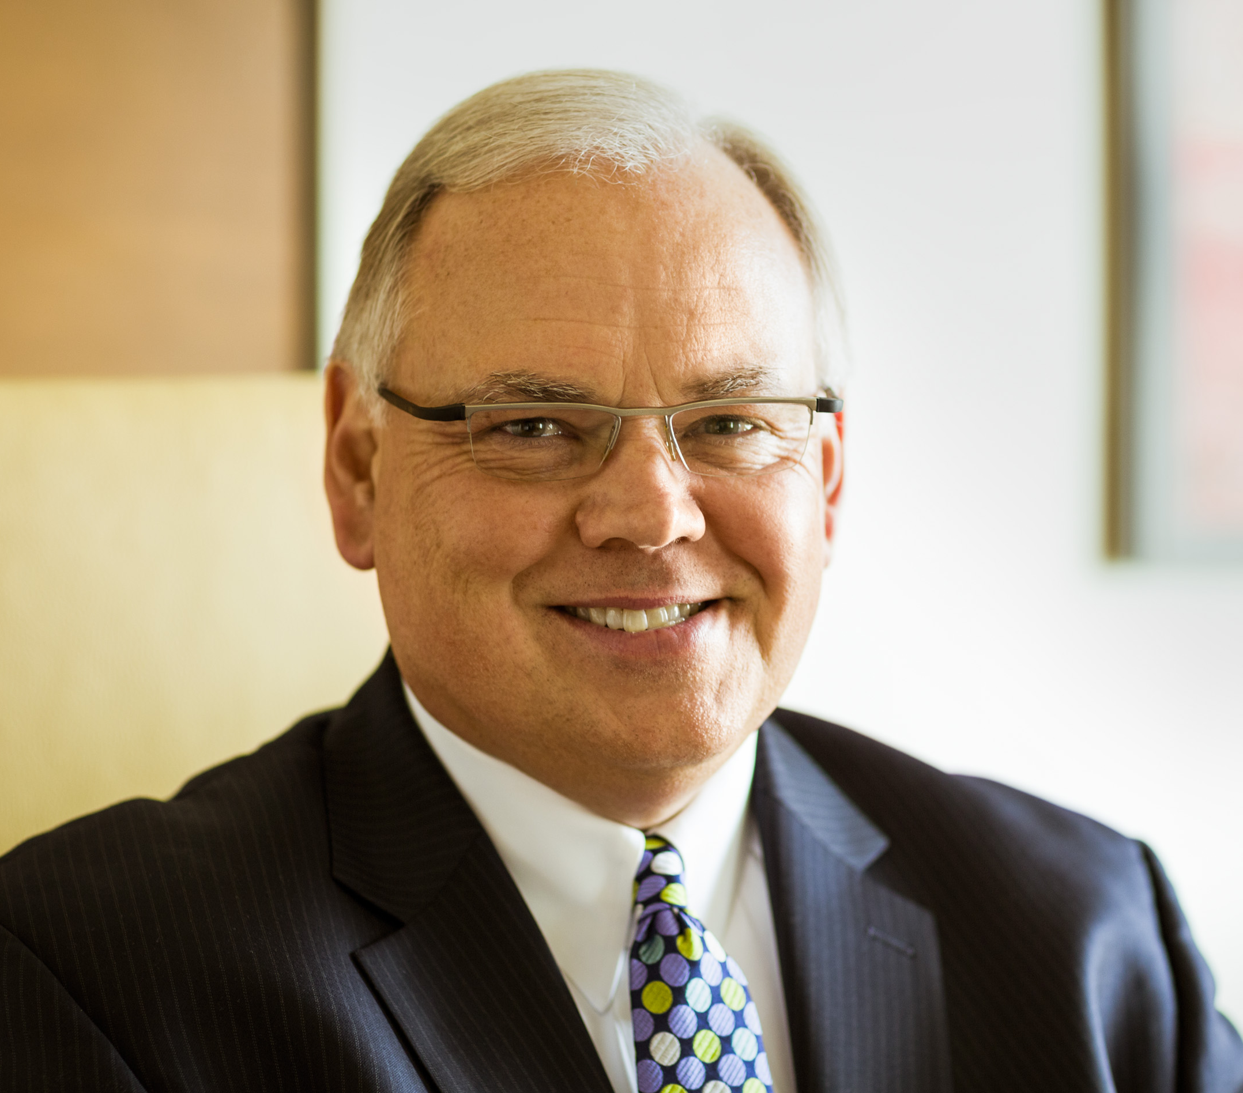
New York Chapter Fall Meeting:
2015 Forecast
You are cordially invited to the MSCI New York Chapter Fall Meeting! Find out what MSCI President, Bob Weidner, expects for 2015 and network with other metals executives from the New York area.
Where: The Landmark
26 Rt. 17 South
East Rutherford, NJ 07073
When: Wednesday, November 28
Cost: $00 per person
About Bob Weidner
Bob Weidner serves as president and CEO of the Metals Service Center Institute (MSCI) and is current Chairman of the National Association of Wholesaler-Distributors’ Association Executives Council (AEC) and a member of the NAW Board of Directors. He is also a member of the U.S. Chamber of Commerce’s Association Committee of 100. In addition, Bob is a member and
2nd Vice Chair of the Council of Manufacturing Executives of the National Association of Manufacturers.
- - - - - - - - - - - - - - - - - - - - - - - - - - - - - - - - - - - - - - - - - - - - - -
Registration Form: New York Chapter Fall Meeting – Nov. 28, 2012 – The Landmark
Please make photocopies for additional registrants. Cut-off Date: November XX, 2015
Name________________________________ Company_____________________
Address________________________ City, State, Zip_______________________
Phone/Fax____________________Email_________________________________
- - - - - - - - - - - - - - - - - - -
Please Indicate Payment:☐$00 per MSCI Member ☐$00 per Non-member
Payment Method: ☐Check payable to MSCI New York Chapter -OR-
☐MasterCard ☐Visa ☐AMEX
Send form & payment to the MSCI New York Chapter: Bryan Doherty at Yarde Metals 603 Murray Road, East Hanover, NJ 07936 Email: bryan.doherty@yarde.com Phone: (973) 463-1166 / Fax: (860) 406-6454
Name on Card____________________________________________________
Account Number______________________ CSV______ Exp. Date__________

Slide 2
[MSCI Chapter Logo]
Title
Subtitle
Intro copy here ----------------------------------------------------------------------------------------------------------------------------------------------------------------------------------------------------------------------------------------------------------------------------------------------------------------------→
Where:
When:
Cost:
[Insert photo here of speaker or location. No clip art.]
Additional Info
Details
- - - - - - - - - - - - - - - - - - - - - - - - - - - - - - - - - - - - - - - - - - - - - -
Registration Form: [Event Name]– [Event Date] – [Event Place]
Please make photocopies for additional registrants. Cut-off Date: [Cut-off Date]
Name________________________________ Company_____________________
Address________________________ City, State, Zip_______________________
Phone/Fax____________________Email_________________________________
- - - - - - - - - - - - - - - - - - -
Please Indicate Payment:☐$00 per MSCI Member ☐$00 per Non-member
Payment Method: ☐Check payable to MSCI New York Chapter -OR-
☐MasterCard ☐Visa ☐AMEX
Send form & payment to the [Chapter Name]: [Name of contact] [Address] Email: [email] Phone: [phone]/ Fax: [fax]
Name on Card____________________________________________________
Account Number______________________ CSV______ Exp. Date__________

